Slide 1

Detailed Analysis of Sales Growth and Revenue of Online Retail Store

Slide 2
Sales snapshot:-
The sales cover a period of three years, specifically from July 2012 to October 2014.
Total Customers: 91
Total Orders placed: 830
Number of orders placed: 2155
Product categories: 78
Supplier companies: 29

Slide 3
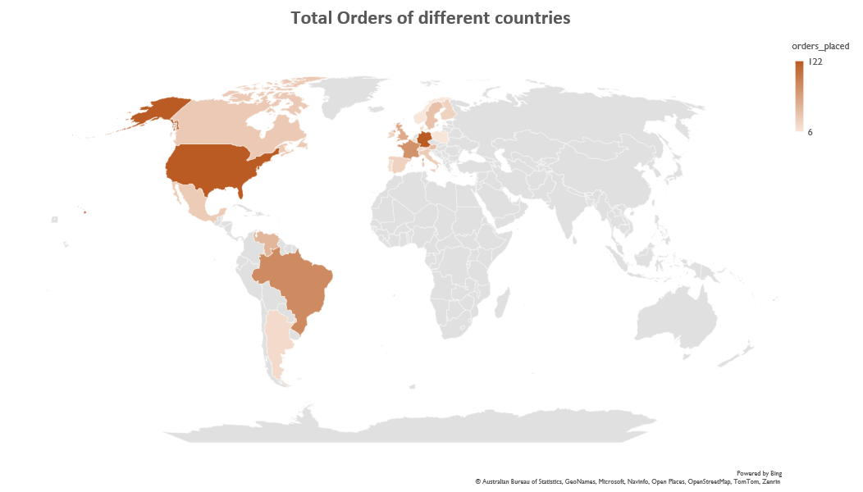
The USA and Germany lead in order placement.
Poland and Norway had the least number of orders.

Slide 4
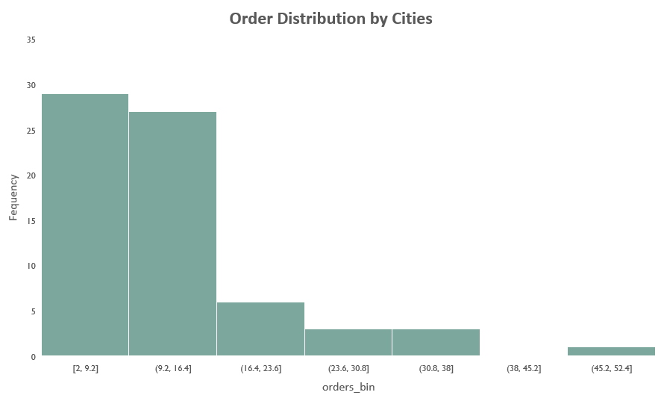
Over half of the cities (56) place less than 20 orders.
Orders above 20 are available in fewer cities.

Slide 5
Total Sales Revenue: 1354458.59(2012-2014)
The revenue was higher in 2013 compared to other years.
Sales data is complete for 2013, but not for 2012 or 2014, making comparisons challenging. However, revenue was strong in 2013.

Slide 6
In the USA and Germany, supplier companies are more and supply more number of products

Slide 7
The amount of product orders does not impact the Revenue. The product that generated the most revenue had only 24 orders.

Slide 8
The average Revenue per customer for all three years is 15218.635843
Based on the 2013 sales data, I conducted a comparative analysis of the average revenue per customer.

